Slide 1
K-means Clustering

Slide 2
What is clustering?
Ch. 16
Clustering: the process of grouping a set of objects into classes of similar objects
Documents within a cluster should be similar.
Documents from different clusters should be dissimilar.
The commonest form of unsupervised learning
Unsupervised learning = learning from raw data, as opposed to supervised data where a classification of examples is given
A common and important task that finds many applications in IR and other places

Slide 3
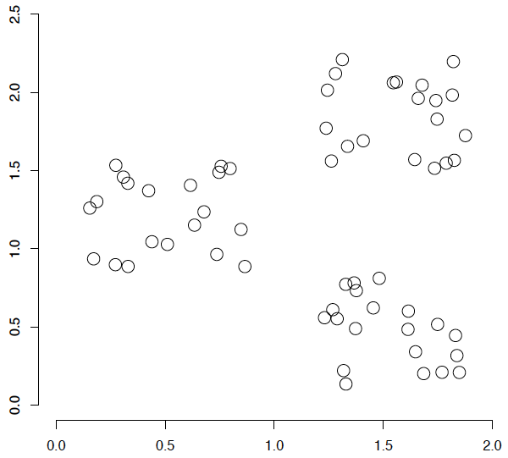
A data set with clear cluster structure
Ch. 16
How would you design an algorithm for finding the three clusters in this case?

Slide 4
K-means Clustering
What is clustering?
Why would we want to cluster?
How would you determine clusters?
How can you do this efficiently?

Slide 5
K-means Clustering
Strengths
Simple iterative method
User provides “K”
Weaknesses
Often too simple → bad results
Difficult to guess the correct “K”

Slide 6
K-means Clustering
Basic Algorithm:
Step 0: select K
Step 1: randomly select initial cluster seeds
Seed 1 650
Seed 2 200

Slide 7
K-means Clustering
An initial cluster seed represents the “mean value” of its cluster.
In the preceding figure:
Cluster seed 1 = 650
Cluster seed 2 = 200

Slide 8
K-means Clustering
Step 2: calculate distance from each object to each cluster seed.
What type of distance should we use?
Squared Euclidean distance
Step 3: Assign each object to the closest cluster

Slide 9
K-means Clustering
Seed 1
Seed 2

Slide 10
K-means Clustering
Step 4: Compute the new centroid for each cluster
Cluster Seed 1 708.9
Cluster Seed 2 214.2

Slide 11
K-means Clustering
Iterate:
Calculate distance from objects to cluster centroids.
Assign objects to closest cluster
Recalculate new centroids
Stop based on convergence criteria
No change in clusters
Max iterations

Slide 12
K-means Issues
Distance measure is squared Euclidean
Scale should be similar in all dimensions
Rescale data?
Not good for nominal data. Why?
Approach tries to minimize the within-cluster sum of squares error (WCSS)
Implicit assumption that SSE is similar for each group

Slide 13
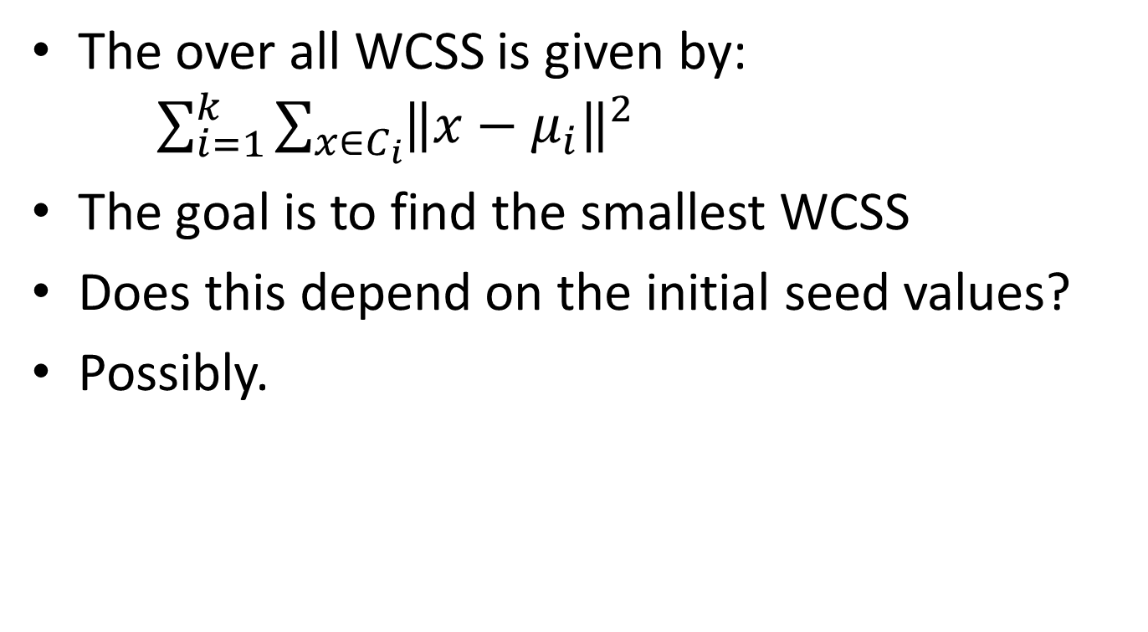
WCSS
The over all WCSS is given by: $\sum_{i=1}^{k}{\sum_{x∈C_{i}}{{\left\|x−μ_{i}\right\|}^{2}}}$
The goal is to find the smallest WCSS
Does this depend on the initial seed values?
Possibly.

Slide 14
Bottom Line
K-means
Easy to use
Need to know K
May need to scale data
Good initial method
Local optima
No guarantee of optimal solution
Repeat with different starting values

Slide 15
K-Means Algorithm summary
Sec. 16.4
Assumes data as real-valued vectors.
Clusters based on centroids (aka the center of gravity or mean) of points in a cluster, c:
Reassignment of instances to clusters is based on distance to the current cluster centroids.
(Or one can equivalently phrase it in terms of similarities)

Slide 16
K-Means Algorithm
Sec. 16.4
Select K random docs {s₁, s₂,… s_{K}} as seeds.
Until clustering converges (or other stopping criterion):
For each class d_{i}:
Assign d_{i} to the cluster c_{j} such that dist(x_{i}, s_{j}) is minimal.
(Next, update the seeds to the centroid of each cluster)
For each cluster c_{j}
s_{j} = μ(c_{j})

Slide 17
K Means Example (K=2)
Sec. 16.4
Pick seeds
Reassign clusters
Compute centroids
Reassign clusters
x
x
x
Compute centroids
x
x
x
Reassign clusters
Converged!

Slide 18
Termination conditions
Sec. 16.4
Several possibilities, e.g.,
A fixed number of iterations.
Class partition unchanged.
Centroid positions don’t change.
Does this mean that the class in a cluster are unchanged?

Slide 19
Convergence of K-Means
Sec. 16.4
Lower case!
Define goodness measure of cluster k as sum of squared distances from cluster centroid:
G_{k} = Σ_{i} (d_{i} – c_{k})² (sum over all d_{i} in cluster k)
G = Σ_{k} G_{k}
Reassignment monotonically decreases G since each vector is assigned to the closest centroid.

Slide 20
Convergence of K-Means
Sec. 16.4
Recomputation monotonically decreases each G_{k} since (m_{k} is number of members in cluster k):
Σ (d_{i} – a)² reaches minimum for:
Σ –2(d_{i} – a) = 0
Σ d_{i} = Σ a
m_{K} a = Σ d_{i}
a = (1/ m_{k}) Σ d_{i} = c_{k}
K-means typically converges quickly

Slide 21
Seed Choice
Sec. 16.4
Results can vary based on random seed selection.
Some seeds can result in poor convergence rate, or convergence to sub-optimal clusterings.
Select good seeds using a heuristic (e.g., class least similar to any existing mean)
Try out multiple starting points
Initialize with the results of another method.

Slide 22
K-means issues, variations, etc.
Sec. 16.4
Recomputing the centroid after every assignment (rather than after all points are re-assigned) can improve speed of convergence of K-means
Assumes clusters are spherical in vector space
Sensitive to coordinate changes, weighting etc.
Disjoint and exhaustive
Doesn’t have a notion of “outliers” by default
But can add outlier filtering
Dhillon et al. ICDM 2002 – variation to fix some issues with small document clusters

